Slide 1
DEVOPS OVERVIEW

Slide 2
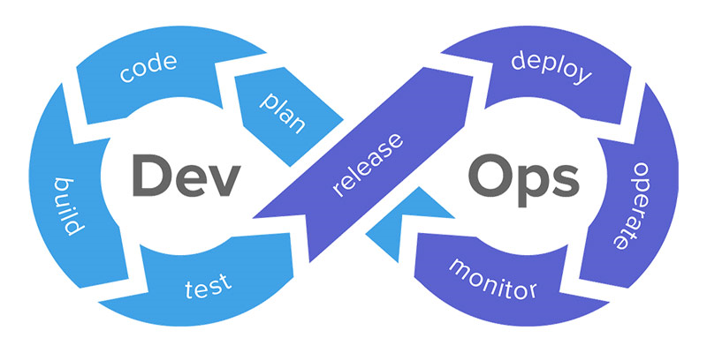
What is DevOps?
DevOps word in itself is a combination of two words one is “Development,” and the other is “Operations.” It is neither an application nor a tool; instead, it is just a culture that collaboratively promotes development and operation. As a result of DevOps implementation, the speed to deliver applications and services has increased.
DevOps enables organizations to serve their customers powerfully and better in the market. In other words, we can say that DevOps is the process of alignment of IT and development operations with better and improved communication.

Slide 3
DEV+OPS
The term DevOps is the blend of two words "Development" and "Operations" This is the kind of practice that permits a single team to handle the complete application of the development cycle namely development, testing, monitoring, and deployment. Eventually, DevOps aims to reduce the development life cycle whilst rendering the features, updates, and fixes in harmony with the business goals and objectives.
Adopting the DevOps culture alongside its tools and practices, the organizations shall be able to respond to their customer's requirements at ease and shall boost the performance of the application significantly, and thus support reaching the business goals at a rapid pace. A DevOps consists of different stages and they are -
Continuous Deployment
Continuous Integration
Continuous Testing
Continuous Deployment
Continuous Monitoring

Slide 4
Needs to Learn DevOps
DevOps is the method of Software development where the development and the operation team collaborates at every stage of the software development cycle. Below in this DevOps Tutorial for Beginners, we have enlisted the important needs to learn DevOps,
It has made innovative and remarkable changes in the practice of Software Development. The complete team takes part in the development process and it aims for the common goal.
When there is continuous integration, then there is a consequent reduction in the manual processes that are involved in the development and testing stages.
It accelerates the chances to work with efficient team members where the knowledge sharing would be significantly higher and helps to have a cordial relationship among the team members.
Last but not the least, with never-ending changes in the IT industry, the demand for skilled DevOps professionals is expected to increase tremendously.

Slide 5
History of DevOps
Before introducing the DevOps the Software Development industry had two main approaches and they are -
1. Waterfall and 2.Agile model of development.
WATERFALL MODEL:
This is the kind of Software Development model which is direct and linear. The Waterfall Model follows the approach of the top-down method.
Also, this model has different starting with the requirement analysis and gatherings. This is the stage where you gather all the requirements from the clients to develop the application.
The next stage is the Designing stage where you are required to prepare the Blueprint for the software. Here, you can sketch out the designs as how your software is going to look like.

Slide 6
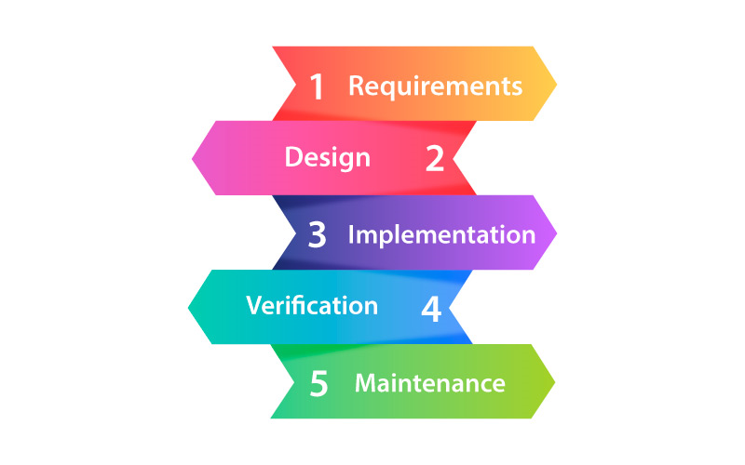
Waterfall Model

Slide 7
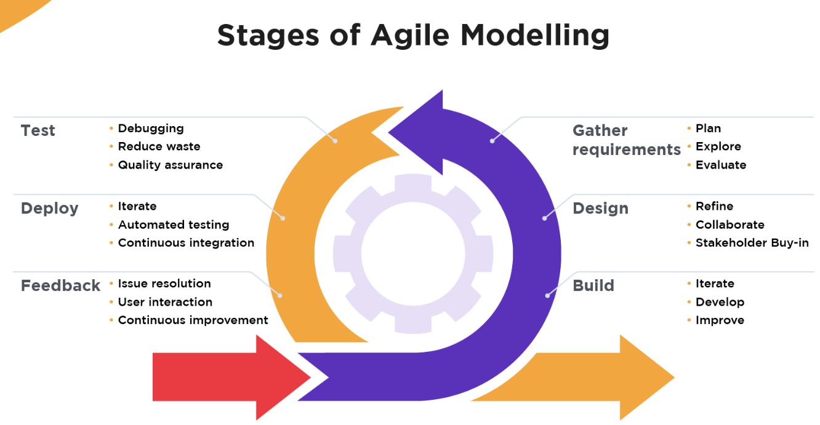
Agile Methodology
It is an iteratively based software development approach where the software project is broken into different sprints and iterations. All the iteration consists of the phases that are found in the waterfall model namely - gathering, requirements, designs, testing, development, and maintenance. The total span of every iteration is 2-8 weeks.

Slide 8
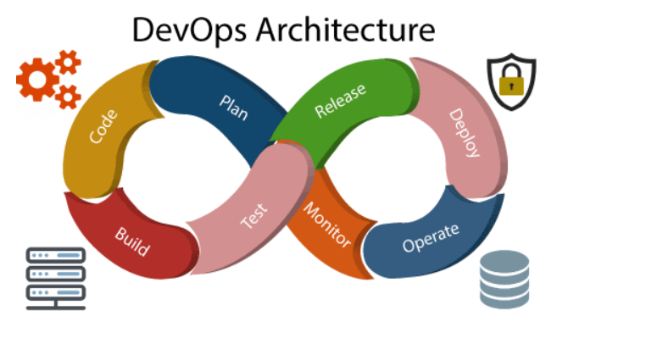
DevOps Architecture
DevOps architecture is used for the applications hosted on the cloud platform and large distributed applications. Agile Development is used in the DevOps architecture so that integration and delivery can be contiguous. When the development and operations team works separately from each other, then it is time-consuming to design, test, and deploy. And if the terms are not in sync with each other, then it may cause a delay in the delivery. So DevOps enables the teams to change their shortcomings and increases productivity.

Slide 9
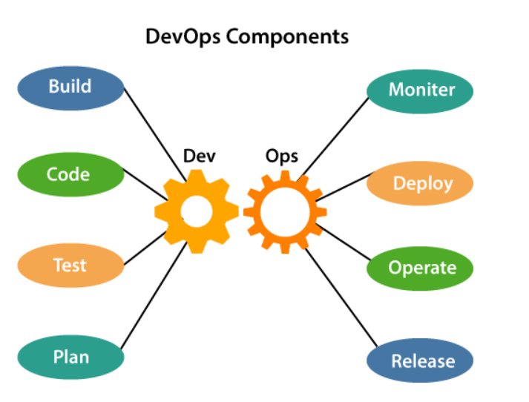
1) Build
Without DevOps, the cost of the consumption of the resources was evaluated based on the pre-defined individual usage with fixed hardware allocation. And with DevOps, the usage of cloud, sharing of resources comes into the picture, and the build is dependent upon the user's need, which is a mechanism to control the usage of resources or capacity.

Slide 10
2) Code
Many good practices such as Git enables the code to be used, which ensures writing the code for business, helps to track changes, getting notified about the reason behind the difference in the actual and the expected output, and if necessary reverting to the original code developed. The code can be appropriately arranged in files, folders, etc. And they can be reused.
3) Test
The application will be ready for production after testing. In the case of manual testing, it consumes more time in testing and moving the code to the output. The testing can be automated, which decreases the time for testing so that the time to deploy the code to production can be reduced as automating the running of the scripts will remove many manual steps.
4) Plan
DevOps use Agile methodology to plan the development. With the operations and development team in sync, it helps in organizing the work to plan accordingly to increase productivity.

Slide 11
5) Monitor
Continuous monitoring is used to identify any risk of failure. Also, it helps in tracking the system accurately so that the health of the application can be checked. The monitoring becomes more comfortable with services where the log data may get monitored through many third-party tools such as Splunk.
6) Deploy
Many systems can support the scheduler for automated deployment. The cloud management platform enables users to capture accurate insights and view the optimization scenario, analytics on trends by the deployment of dashboards.
7) Operate
DevOps changes the way traditional approach of developing and testing separately. The teams operate in a collaborative way where both the teams actively participate throughout the service lifecycle. The operation team interacts with developers, and they come up with a monitoring plan which serves the IT and business requirements.

Slide 12
8) Release
Deployment to an environment can be done by automation. But when the deployment is made to the production environment, it is done by manual triggering. Many processes involved in release management commonly used to do the deployment in the production environment manually to lessen the impact on the customers.

Slide 13
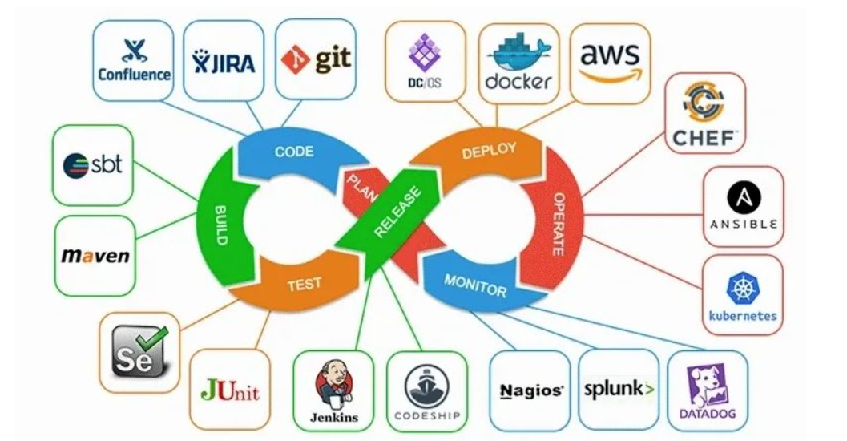
DEVOPS TOOLS

Slide 14
DEVOPS TOOLS
1)Git:
Git is an open-source distributed version control system that is freely available for everyone. It is designed to handle minor to major projects with speed and efficiency. It is developed to co-ordinate the work among programmers. The version control allows you to track and work together with your team members at the same workspace. It is used as a critical distributed version-control for the DevOps tool.
Features
It is a free open source tool.
It allows distributed development.
It supports the pull request.
It enables a faster release cycle.
Git is very scalable.
It is very secure and completes the tasks very fast.

Slide 15
DEVOPS TOOLS
2) Jenkins:
Jenkins is a DevOps tool for monitoring the execution of repeated tasks. Jenkins is a software that allows continuous integration. Jenkins will be installed on a server where the central build will take place. It helps to integrate project changes more efficiently by finding the issues quickly.
Features
Jenkins increases the scale of automation.
It can easily set up and configure via a web interface.
It can distribute the tasks across multiple machines, thereby increasing concurrency.
It supports continuous integration and continuous delivery.
It offers 400 plugins to support the building and testing any project virtually.
It requires little maintenance and has a built-in GUI tool for easy updates.

Slide 16
DEVOPS TOOLS
3) Selenium:
Selenium is a portable software testing framework for web applications. It provides an easy interface for developing automated tests.
Features
It is a free open source tool.
It supports multiplatform for testing, such as Android and ios.
It is easy to build a keyword-driven framework for a WebDriver.
It creates robust browser-based regression automation suites and tests.
4)Puppet:
Puppet is the most widely used DevOps tool. It allows the delivery and release of the technology changes quickly and frequently. It has features of versioning, automated testing, and continuous delivery. It enables to manage entire infrastructure as code without expanding the size of the team.

Slide 17
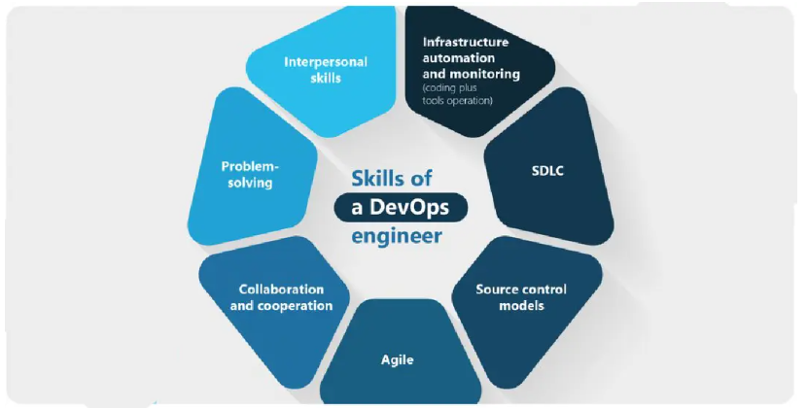
DevOps Skills in demand

